Slide 1
Classification: Advanced Methods
Lecture 5

Slide 2
Nearest Neighbor Classifiers
Basic idea:
If it walks like a duck, quacks like a duck, then it’s probably a duck
Compute Distance
Test Record
Training Records
Choose k of the “nearest” records

Slide 3
Nearest-Neighbor Classifiers
Requires the following:
A set of labeled records
Proximity metric to compute distance/similarity between a pair of records
e.g., Euclidean distance
The value of k, the number of nearest neighbors to retrieve
A method for using class labels of K nearest neighbors to determine the class label of unknown record (e.g., by taking majority vote)

Slide 4

How to Determine the class label of a Test Sample?
Take the majority vote of class labels among the k-nearest neighbors
Weight the vote according to distance
weight factor, $w = 1/d2$

Slide 5
Nearest Neighbor Classification…
Data preprocessing is often required
Attributes may have to be scaled to prevent distance measures from being dominated by one of the attributes
Example:
height of a person may vary from 1.5m to 1.8m
weight of a person may vary from 90lb to 300lb
income of a person may vary from $10K to $1M
Time series are often standardized to have 0 means a standard deviation of 1

Slide 6
Nearest Neighbor Classification…
Choosing the value of k:
If k is too small, sensitive to noise points
If k is too large, neighborhood may include points from other classes

Slide 7
Improving KNN Efficiency
Avoid having to compute distance to all objects in the training set
Multi-dimensional access methods (k-d trees)
Fast approximate similarity search
Locality Sensitive Hashing (LSH)
Condensing
Determine a smaller set of objects that give the same performance
Editing
Remove objects to improve efficiency

Slide 8
Support Vector Machines
Find a linear hyperplane (decision boundary) that will separate the data

Slide 9
Support Vector Machines
One Possible Solution

Slide 10
Support Vector Machines
Another possible solution

Slide 11
Support Vector Machines
Other possible solutions

Slide 12
Support Vector Machines
Which one is better? B1 or B2?
How do you define better?

Slide 13
Support Vector Machines
Find hyperplane maximizes the margin => B1 is better than B2

Slide 14
Support Vector Machines

Slide 15
Linear SVM
Linear model:
Learning the model is equivalent to determining the values of
How to find from training data?

Slide 16
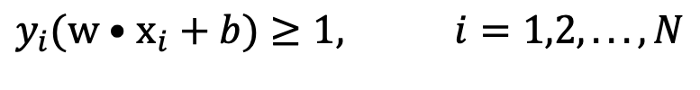
Learning Linear SVM
Objective is to maximize:
Which is equivalent to minimizing:
Subject to the following constraints:
or
This is a constrained optimization problem
Solve it using Lagrange multiplier method
$$y_{i}(w•x_{i}+b)≥1, i=1,2,...,N$$

Slide 17
Example of Linear SVM
Support vectors

Slide 18
Learning Linear SVM
Decision boundary depends only on support vectors
If you have data set with same support vectors, decision boundary will not change
How to classify using SVM once w and b are found? Given a test record, x_{i}

Slide 19
Support Vector Machines
What if the problem is not linearly separable?

Slide 20
Support Vector Machines
What if the problem is not linearly separable?
Introduce slack variables
Need to minimize:
Subject to:
If k is 1 or 2, this leads to similar objective function as linear SVM but with different constraints (see textbook)

Slide 21
Support Vector Machines
Find the hyperplane that optimizes both factors

Slide 22
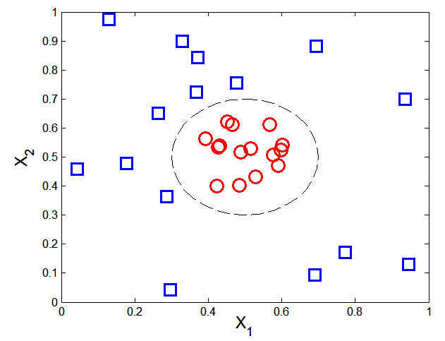

Nonlinear Support Vector Machines
What if decision boundary is not linear?

Slide 23
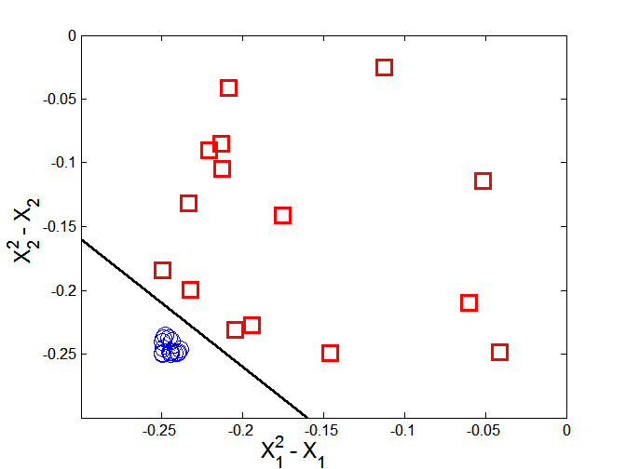



Nonlinear Support Vector Machines
Transform data into higher dimensional space
Decision boundary:

Slide 24
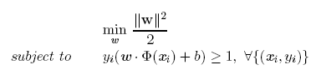

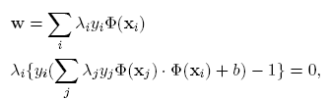

Learning Nonlinear SVM
Optimization problem:
Which leads to the same set of equations (but involve Φ(x) instead of x)

Slide 25
Learning NonLinear SVM
Issues:
What type of mapping function Φ should be used?
How to do the computation in high dimensional space?
Most computations involve dot product Φ(x_{i})• Φ(x_{j})
Curse of dimensionality?

Slide 26

Learning Nonlinear SVM
Kernel Trick:
Φ(x_{i})• Φ(x_{j}) = K(x_{i}, x_{j})
K(x_{i}, x_{j}) is a kernel function (expressed in terms of the coordinates in the original space)
Examples:

Slide 27
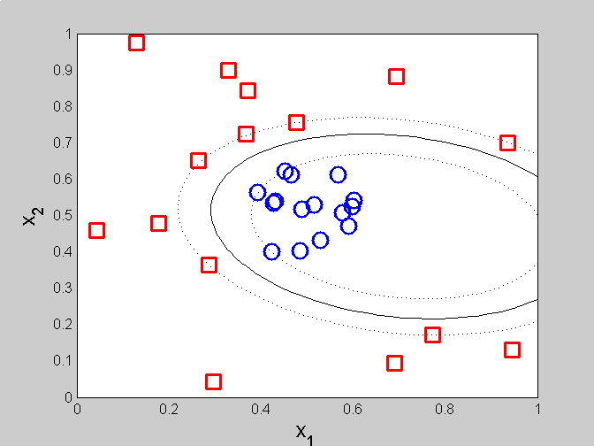
Example of Nonlinear SVM
SVM with polynomial degree 2 kernel

Slide 28
Learning Nonlinear SVM
Advantages of using kernel:
Don’t have to know the mapping function Φ
Computing dot product Φ(x_{i})• Φ(x_{j}) in the original space avoids curse of dimensionality
Not all functions can be kernels
Must make sure there is a corresponding Φ in some high-dimensional space
Mercer’s theorem (see textbook)

Slide 29
Characteristics of SVM
The learning problem is formulated as a convex optimization problem
Efficient algorithms are available to find the global minima
Many of the other methods use greedy approaches and find locally optimal solutions
High computational complexity for building the model
Robust to noise
Overfitting is handled by maximizing the margin of the decision boundary,
SVM can handle irrelevant and redundant attributes better than many other techniques
The user needs to provide the type of kernel function and cost function
Difficult to handle missing values
What about categorical variables?

Slide 30
Support Vector Machines

Slide 31
Artificial Neural Networks (ANN)
Basic Idea: A complex non-linear function can be learned as a composition of simple processing units
ANN is a collection of simple processing units (nodes) that are connected by directed links (edges)
Every node receives signals from incoming edges, performs computations, and transmits signals to outgoing edges
Analogous to human brain where nodes are neurons and signals are electrical impulses
Weight of an edge determines the strength of connection between the nodes
Simplest ANN: Perceptron (single neuron)

Slide 32
Basic Architecture of Perceptron
Activation Function
Learns linear decision boundaries
Related to logistic regression (activation function is sign instead of sigmoid)

Slide 33
Perceptron Example
Output Y is 1 if at least two of the three inputs are equal to 1.

Slide 34
Perceptron Example

Slide 35
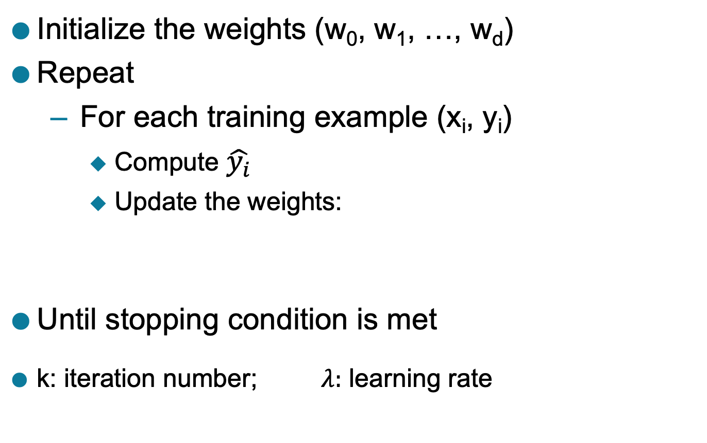
Perceptron Learning Rule
Initialize the weights (w₀, w₁, …, w_{d})
Repeat
For each training example (x_{i}, y_{i})
Compute $\hat{y_{i}}$
Update the weights:
Until stopping condition is met
k: iteration number; $λ:$ learning rate

Slide 36
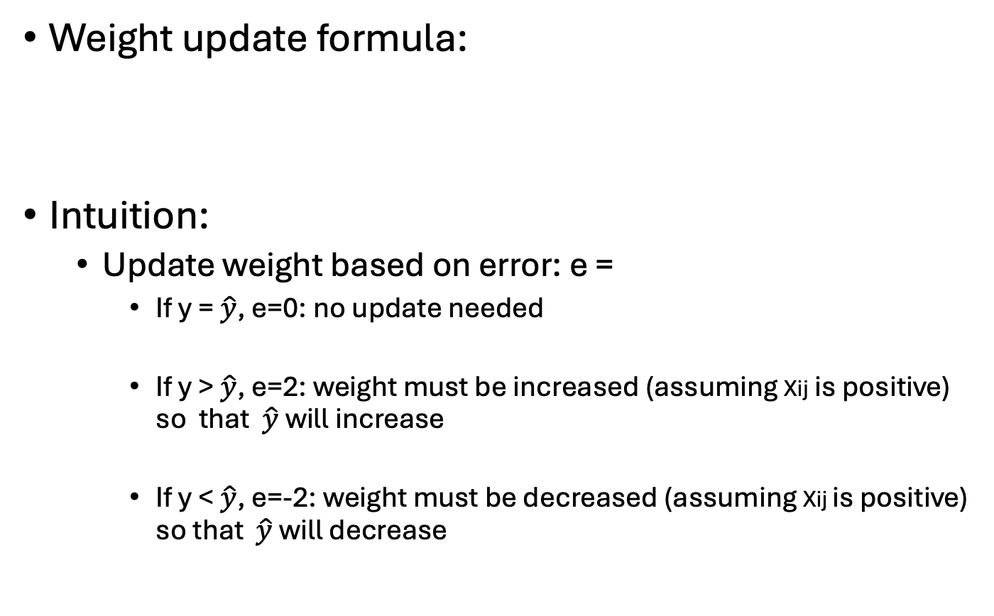
Perceptron Learning Rule
Weight update formula:
Intuition:
Update weight based on error: e =
If y = $\hat{y}$, e=0: no update needed
If y > $\hat{y}$, e=2: weight must be increased (assuming Xij is positive) so that $\hat{y}$ will increase
If y < $\hat{y}$, e=-2: weight must be decreased (assuming Xij is positive) so that $\hat{y}$ will decrease

Slide 37
Example of Perceptron Learning
Weight updates over all epochs
Weight updates over first epoch

Slide 38
Perceptron Learning
Since y is a linear combination of input variables, decision boundary is linear

Slide 39
Nonlinearly Separable Data
For nonlinearly separable problems, perceptron learning algorithm will fail because no linear hyperplane can separate the data perfectly
XOR Data

Slide 40
Multi-layer Neural Network
More than one hidden layer of computing nodes
Every node in a hidden layer operates on activations from preceding layer and transmits activations forward to nodes of next layer
Also referred to as “feedforward neural networks”
Notes:
Hidden layers represent levels of abstraction. ANN models provide a natural way of representing features at multiple levels of abstraction, where complex features are seen as compositions of simpler features. In many classification problems, modeling such a hierarchy of features turns out to be very useful. For example, in order to detect a human face in an image, we can first identify low-level features such as sharp edges with different gradients and orientations. These features can then be combined to identify facial parts such as eyes, nose, ears, and lips. Finally, an appropriate arrangement of facial parts can be used to correctly identify a human face. ANN models provide a powerful architecture to represent a hierarchical abstraction of features, from
k lower levels of abstraction (e.g., edges) to higher levels (e.g., facial parts).

Slide 41
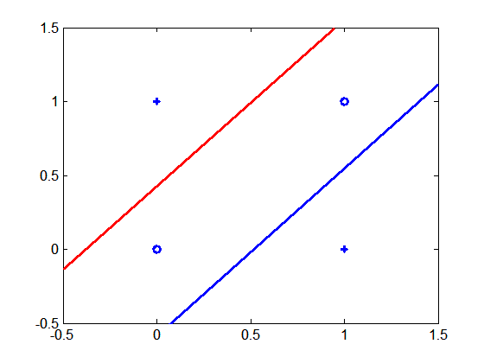
Multi-layer Neural Network
Multi-layer neural networks with at least one hidden layer can solve any type of classification task involving nonlinear decision surfaces
XOR Data

Slide 42
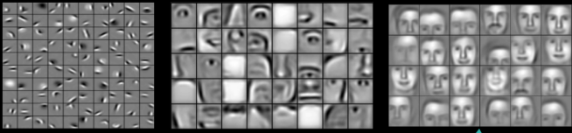
Why Multiple Hidden Layers?
Activations at hidden layers can be viewed as features extracted as functions of inputs
Every hidden layer represents a level of abstraction
Complex features are compositions of simpler features
Number of layers is known as depth of ANN
Deeper networks express complex hierarchy of features
Notes:
ANN models provide a natural way of representing features at multiple levels of abstraction, where complex features are seen as compositions of simpler features. In many classification problems, modeling such a hierarchy of features turns out to be very useful. For example, in order to detect a human face in an image, we can first identify low-level features such as sharp edges with different gradients and orientations. These features can then be combined to identify facial parts such as eyes, nose, ears, and lips. Finally, an appropriate arrangement of facial parts can be used to correctly identify a human face. ANN models provide a powerful architecture to represent a hierarchical abstraction of features, from
k lower levels of abstraction (e.g., edges) to higher levels (e.g., facial parts).

Slide 43
Multi-Layer Network Architecture
Activation value at node i at layer l
Activation Function
Linear Predictor

Slide 44
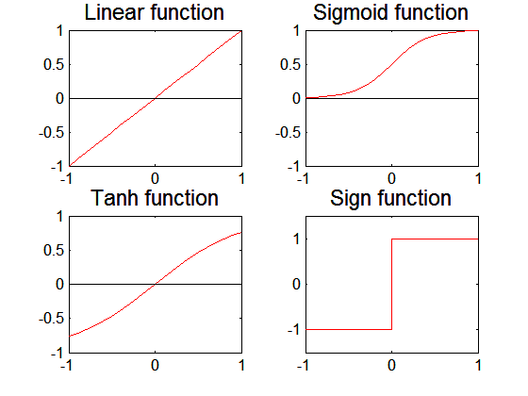
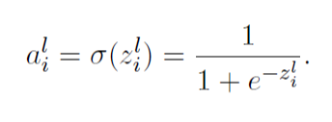
Activation Functions

Slide 45
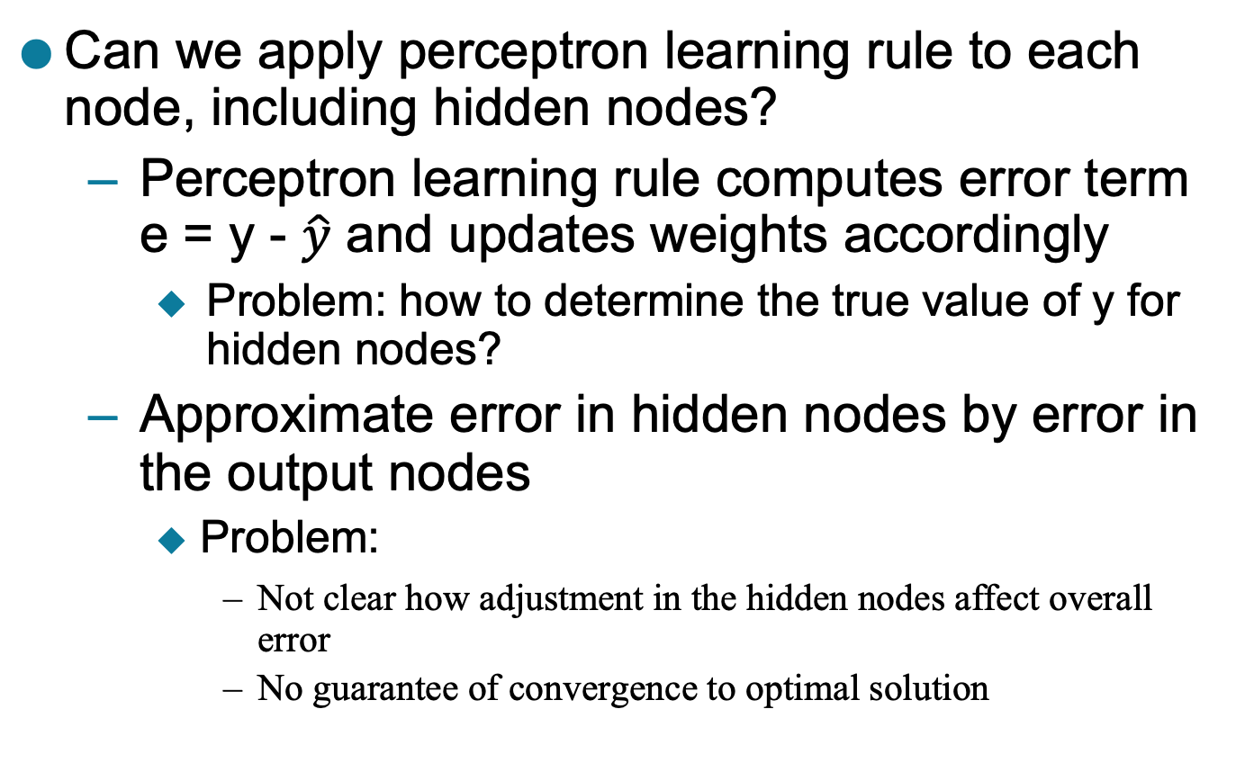
Learning Multi-layer Neural Network
Can we apply perceptron learning rule to each node, including hidden nodes?
Perceptron learning rule computes error term e = y - $\hat{y}$ and updates weights accordingly
Problem: how to determine the true value of y for hidden nodes?
Approximate error in hidden nodes by error in the output nodes
Problem:
Not clear how adjustment in the hidden nodes affect overall error
No guarantee of convergence to optimal solution

Slide 46
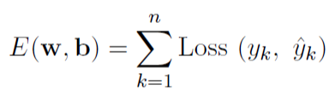

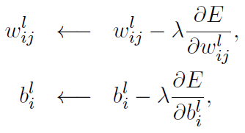

Gradient Descent
Squared Loss:
Loss Function to measure errors across all training points
Gradient descent: Update parameters in the direction of “maximum descent” in the loss function across all points
Stochastic gradient descent (SGD): update the weight for every instance (minibatch SGD: update over min-batches of instances)
$λ$: learning rate

Slide 47
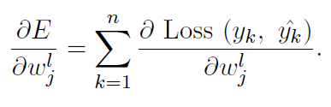

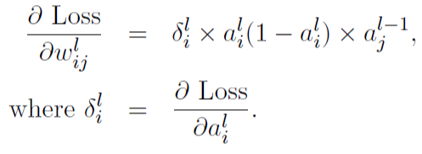




Computing Gradients
$$\hat{y}=a^{L}$$
$$ij$$
$$ij$$
Using chain rule of differentiation (on a single instance):
For sigmoid activation function:
How can we compute $δ_{i}^{l}$ for every layer?

Slide 48
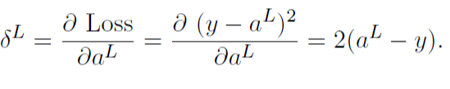
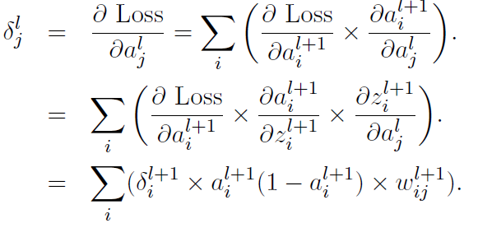
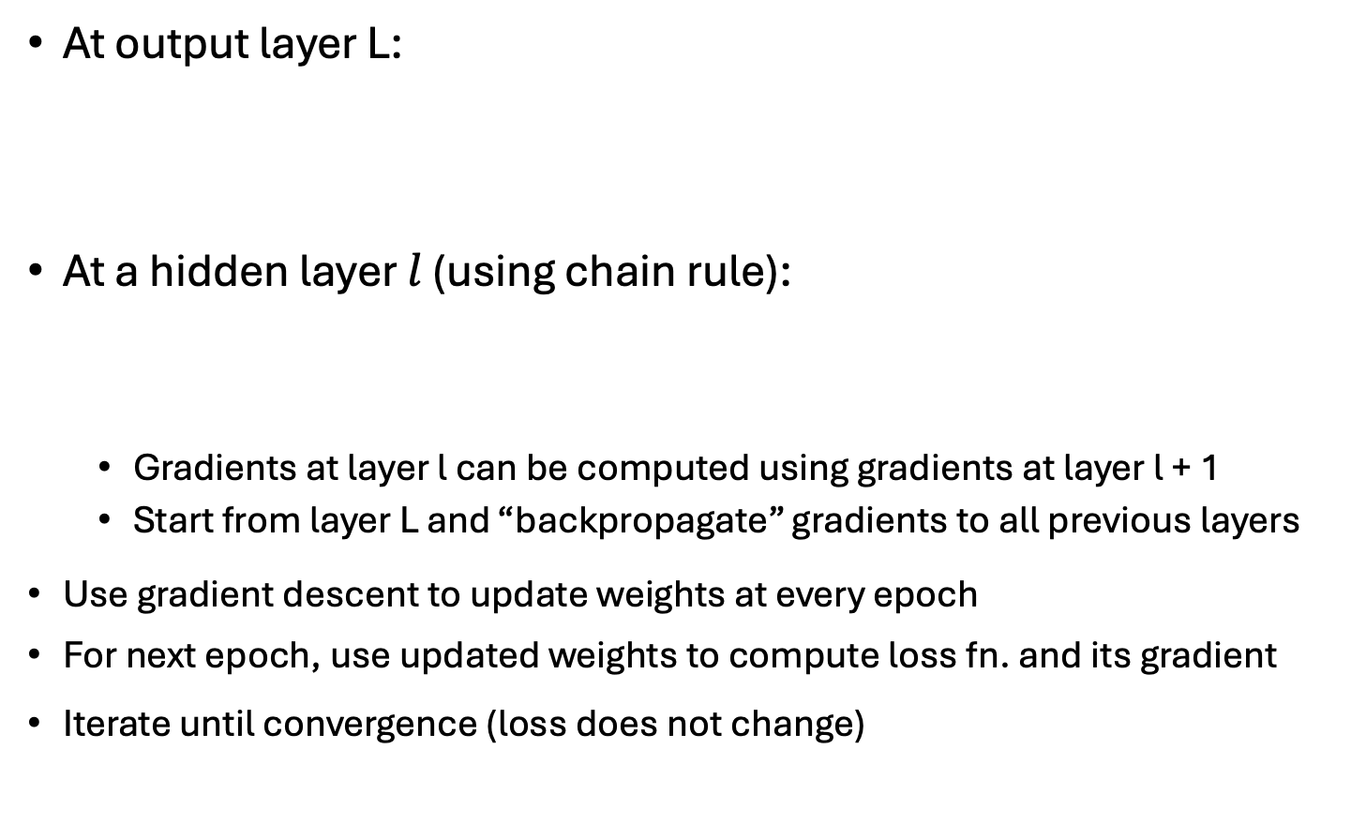
Backpropagation Algorithm
At output layer L:
At a hidden layer $l$ (using chain rule):
Gradients at layer l can be computed using gradients at layer l + 1
Start from layer L and “backpropagate” gradients to all previous layers
Use gradient descent to update weights at every epoch
For next epoch, use updated weights to compute loss fn. and its gradient
Iterate until convergence (loss does not change)

Slide 49
Design Issues in ANN
Number of nodes in input layer
One input node per binary/continuous attribute
k or log₂ k nodes for each categorical attribute with k values
Number of nodes in output layer
One output for binary class problem
k or log₂ k nodes for k-class problem
Number of hidden layers and nodes per layer
Initial weights and biases
Learning rate, max. number of epochs, mini-batch size for mini-batch SGD, …

Slide 50
Characteristics of ANN
Multilayer ANN are universal approximators but could suffer from overfitting if the network is too large
Naturally represents a hierarchy of features at multiple levels of abstractions
Gradient descent may converge to local minimum
Model building is compute intensive, but testing is fast
Can handle redundant and irrelevant attributes because weights are automatically learnt for all attributes
Sensitive to noise in training data
This issue can be addressed by incorporating model complexity in the loss function
Difficult to handle missing attributes

Slide 51
Deep Learning Trends
Training deep neural networks (more than 5-10 layers) could only be possible in recent times with:
Faster computing resources (GPU)
Larger labeled training sets
Algorithmic Improvements in Deep Learning
Responsive activation functions (e.g., RELU)
Regularization (e.g., Dropout)
Supervised pre-training
Unsupervised pre-training (auto-encoders)
Specialized ANN Architectures:
Convolutional Neural Networks (for image data)
Recurrent Neural Networks (for sequence data)
Residual Networks (with skip connections)
Generative Models: Generative Adversarial Networks

Slide 52
Classification by Backpropagation
Backpropagation: A neural network learning algorithm
Started by psychologists and neurobiologists to develop and test computational analogues of neurons
A neural network: A set of connected input/output units where each connection has a weight associated with it
During the learning phase, the network learns by adjusting the weights so as to be able to predict the correct class label of the input tuples
Also referred to as connectionist learning due to the connections between units

Slide 53
Neural Network as a Classifier
Weakness
Long training time
Require a number of parameters typically best determined empirically, e.g., the network topology or “structure.”
Poor interpretability: Difficult to interpret the symbolic meaning behind the learned weights and of “hidden units” in the network
Strength
High tolerance to noisy data
Ability to classify untrained patterns
Well-suited for continuous-valued inputs and outputs
Successful on an array of real-world data, e.g., hand-written letters
Algorithms are inherently parallel
Techniques have recently been developed for the extraction of rules from trained neural networks

Slide 54
A Multi-Layer Feed-Forward Neural Network
Output vector
Output layer
Hidden layer
w_{ij}
Input layer
Input vector: X
Notes:
MK: Note – different notation than used in book. Will have to standardize notation.

Slide 55
How A Multi-Layer Neural Network Works
The inputs to the network correspond to the attributes measured for each training tuple
Inputs are fed simultaneously into the units making up the input layer
They are then weighted and fed simultaneously to a hidden layer
The number of hidden layers is arbitrary, although usually only one
The weighted outputs of the last hidden layer are input to units making up the output layer, which emits the network's prediction
The network is feed-forward: None of the weights cycles back to an input unit or to an output unit of a previous layer
From a statistical point of view, networks perform nonlinear regression: Given enough hidden units and enough training samples, they can closely approximate any function

Slide 56
Defining a Network Topology
Decide the network topology: Specify # of units in the input layer, # of hidden layers (if > 1), # of units in each hidden layer, and # of units in the output layer
Normalize the input values for each attribute measured in the training tuples to [0.0—1.0]
One input unit per domain value, each initialized to 0
Output, if for classification and more than two classes, one output unit per class is used
Once a network has been trained and its accuracy is unacceptable, repeat the training process with a different network topology or a different set of initial weights

Slide 57
Backpropagation
Iteratively process a set of training tuples & compare the network's prediction with the actual known target value
For each training tuple, the weights are modified to minimize the mean squared error between the network's prediction and the actual target value
Modifications are made in the “backwards” direction: from the output layer, through each hidden layer down to the first hidden layer, hence “backpropagation”
Steps
Initialize weights to small random numbers, associated with biases
Propagate the inputs forward (by applying activation function)
Backpropagate the error (by updating weights and biases)
Terminating condition (when error is very small, etc.)

Slide 58
Neuron: A Hidden/Output Layer Unit
bias
μ_{k}
x₀
w₀
x₁
w₁
∑
f
output y
x_{n}
w_{n}
Input
vector x
weight
vector w
weighted
sum
Activation
function
An n-dimensional input vector x is mapped into variable y by means of the scalar product and a nonlinear function mapping
The inputs to unit are outputs from the previous layer. They are multiplied by their corresponding weights to form a weighted sum, which is added to the bias associated with unit. Then a nonlinear activation function is applied to it.
58
Notes:
58

Slide 59
Efficiency and Interpretability
Efficiency of backpropagation: Each epoch (one iteration through the training set) takes O(|D| * w), with |D| tuples and w weights, but # of epochs can be exponential to n, the number of inputs, in worst case
For easier comprehension: Rule extraction by network pruning
Simplify the network structure by removing weighted links that have the least effect on the trained network
Then perform link, unit, or activation value clustering
The set of input and activation values are studied to derive rules describing the relationship between the input and hidden unit layers
Sensitivity analysis: assess the impact that a given input variable has on a network output. The knowledge gained from this analysis can be represented in rules

Slide 60
Classification: A Mathematical Mapping
Classification: predicts categorical class labels
E.g., Personal homepage classification
x_{i} = (x₁, x₂, x₃, …), y_{i} = +1 or –1
x₁ : # of word “homepage”
x₂ : # of word “welcome”
Mathematically, x ∈ X = ℜ^{n}, y ∈ Y = {+1, –1},
We want to derive a function f: X → Y
Linear Classification
Binary Classification problem
Data above the red line belongs to class ‘x’
Data below red line belongs to class ‘o’
Examples: SVM, Perceptron, Probabilistic Classifiers
x
x
x
x
x
x
x
x
x
o
o
x
o
o
o
o
o
o
o
o
o
o
o
60
Notes:
60

Slide 61
Discriminative Classifiers
Advantages
Prediction accuracy is generally high
As compared to Bayesian methods – in general
Robust, works when training examples contain errors
Fast evaluation of the learned target function
Bayesian networks are normally slow
Criticism
Long training time
Difficult to understand the learned function (weights)
Bayesian networks can be used easily for pattern discovery
Not easy to incorporate domain knowledge
Easy in the form of priors on the data or distributions
61
Notes:
61

Slide 62
SVM—Support Vector Machines
A relatively new classification method for both linear and nonlinear data
It uses a nonlinear mapping to transform the original training data into a higher dimension
With the new dimension, it searches for the linear optimal separating hyperplane (i.e., “decision boundary”)
With an appropriate nonlinear mapping to a sufficiently high dimension, data from two classes can always be separated by a hyperplane
SVM finds this hyperplane using support vectors (“essential” training tuples) and margins (defined by the support vectors)

Slide 63
SVM—History and Applications
Vapnik and colleagues (1992)—groundwork from Vapnik & Chervonenkis’ statistical learning theory in 1960s
Features: training can be slow but accuracy is high owing to their ability to model complex nonlinear decision boundaries (margin maximization)
Used for: classification and numeric prediction
Applications:
handwritten digit recognition, object recognition, speaker identification, benchmarking time-series prediction tests

Slide 64
SVM vs. Neural Network
SVM
Deterministic algorithm
Nice generalization properties
Hard to learn – learned in batch mode using quadratic programming techniques
Using kernels can learn very complex functions
Neural Network
Nondeterministic algorithm
Generalizes well but doesn’t have strong mathematical foundation
Can easily be learned in incremental fashion
To learn complex functions—use multilayer perceptron (nontrivial)

Slide 65
Lazy vs. Eager Learning
Lazy vs. eager learning
Lazy learning (e.g., instance-based learning): Simply stores training data (or only minor processing) and waits until it is given a test tuple
Eager learning (the above discussed methods): Given a set of training tuples, constructs a classification model before receiving new (e.g., test) data to classify
Lazy: less time in training but more time in predicting
Accuracy
Lazy method effectively uses a richer hypothesis space since it uses many local linear functions to form an implicit global approximation to the target function
Eager: must commit to a single hypothesis that covers the entire instance space

Slide 66
Lazy Learner: Instance-Based Methods
Instance-based learning:
Store training examples and delay the processing (“lazy evaluation”) until a new instance must be classified
Typical approaches
k-nearest neighbor approach
Instances represented as points in a Euclidean space.
Locally weighted regression
Constructs local approximation
Case-based reasoning
Uses symbolic representations and knowledge-based inference

Slide 67
Multiclass Classification
Classification involving more than two classes (i.e., > 2 Classes)
Method 1. One-vs.-all (OVA): Learn a classifier one at a time
Given m classes, train m classifiers: one for each class
Classifier j: treat tuples in class j as positive & all others as negative
To classify a tuple X, the set of classifiers vote as an ensemble
Method 2. All-vs.-all (AVA): Learn a classifier for each pair of classes
Given m classes, construct m(m-1)/2 binary classifiers
A classifier is trained using tuples of the two classes
To classify a tuple X, each classifier votes. X is assigned to the class with maximal vote
Comparison
All-vs.-all tends to be superior to one-vs.-all
Problem: Binary classifier is sensitive to errors, and errors affect vote count
67

Slide 68
Semi-Supervised Classification
Semi-supervised: Uses labeled and unlabeled data to build a classifier
Self-training:
Build a classifier using the labeled data
Use it to label the unlabeled data, and those with the most confident label prediction are added to the set of labeled data
Repeat the above process
Adv: easy to understand; disadv: may reinforce errors
Co-training: Use two or more classifiers to teach each other
Each learner uses a mutually independent set of features of each tuple to train a good classifier, say f₁
Then f₁ and f₂ are used to predict the class label for unlabeled data X
Teach each other: The tuple having the most confident prediction from f₁ is added to the set of labeled data for f₂, & vice versa
Other methods, e.g., joint probability distribution of features and labels
68

Slide 69
Active Learning
Class labels are expensive to obtain
Active learner: query human (oracle) for labels
Pool-based approach: Uses a pool of unlabeled data
L: a small subset of D is labeled, U: a pool of unlabeled data in D
Use a query function to carefully select one or more tuples from U and request labels from an oracle (a human annotator)
The newly labeled samples are added to L, and learn a model
Goal: Achieve high accuracy using as few labeled data as possible
Evaluated using learning curves: Accuracy as a function of the number of instances queried (# of tuples to be queried should be small)
Research issue: How to choose the data tuples to be queried?
Uncertainty sampling: choose the least certain ones
Reduce version space, the subset of hypotheses consistent w. the training data
Reduce expected entropy over U: Find the greatest reduction in the total number of incorrect predictions
69

Slide 70
Transfer Learning: Conceptual Framework
Transfer learning: Extract knowledge from one or more source tasks and apply the knowledge to a target task
Traditional learning: Build a new classifier for each new task
Transfer learning: Build new classifier by applying existing knowledge learned from source tasks
Traditional Learning Framework
Transfer Learning Framework
70

Slide 71
Transfer Learning: Methods and Applications
Applications: Especially useful when data is outdated or distribution changes, e.g., Web document classification, e-mail spam filtering
Instance-based transfer learning: Reweight some of the data from source tasks and use it to learn the target task
TrAdaBoost (Transfer AdaBoost)
Assume source and target data each described by the same set of attributes (features) & class labels, but rather diff. distributions
Require only labeling a small amount of target data
Use source data in training: When a source tuple is misclassified, reduce the weight of such tupels so that they will have less effect on the subsequent classifier
Research issues
Negative transfer: When it performs worse than no transfer at all
Heterogeneous transfer learning: Transfer knowledge from different feature space or multiple source domains
Large-scale transfer learning
71

Slide 72
Ensemble Methods
Construct a set of base classifiers learned from the training data
Predict class label of test records by combining the predictions made by multiple classifiers (e.g., by taking majority vote)

Slide 73
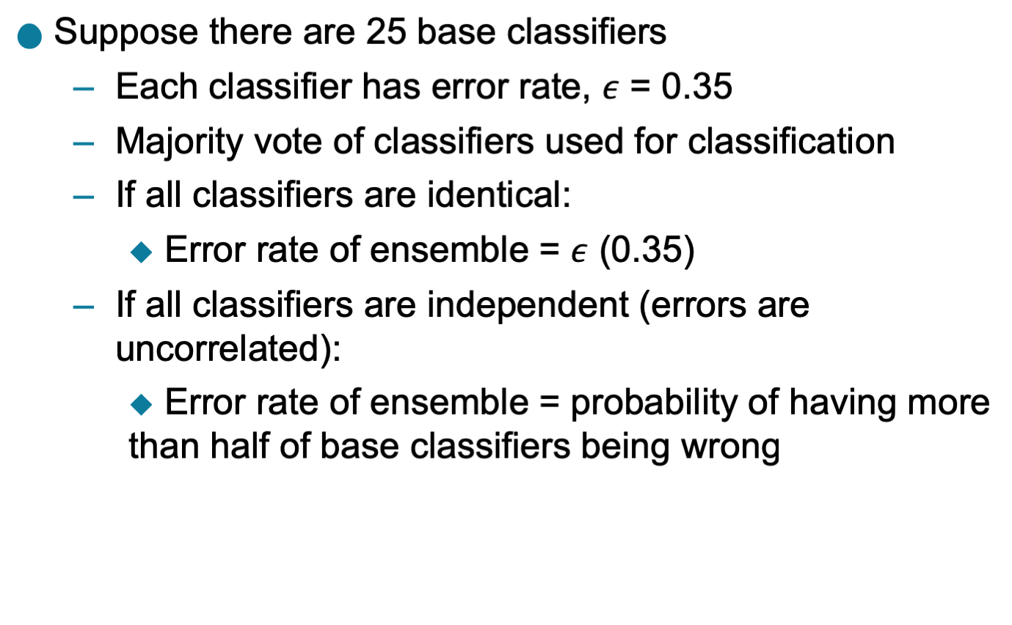
Example: Why Do Ensemble Methods Work?

Slide 74
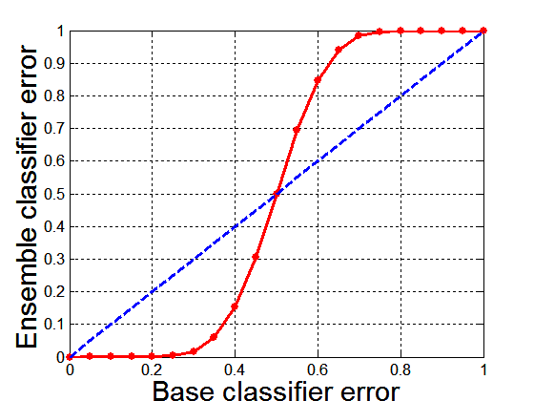
Necessary Conditions for Ensemble Methods
Ensemble Methods work better than a single base classifier if:
All base classifiers are independent of each other
All base classifiers perform better than random guessing (error rate < 0.5 for binary classification)
Classification error for an ensemble of 25 base classifiers, assuming their errors are uncorrelated.

Slide 75
Rationale for Ensemble Learning
Ensemble Methods work best with unstable base classifiers
Classifiers that are sensitive to minor perturbations in training set, due to high model complexity
Examples: Unpruned decision trees, ANNs, …

Slide 76

Bias-Variance Decomposition
Analogous problem of reaching a target y by firing projectiles from x (regression problem)
For classification, the generalization error of model $m$ can be given by:
$$gen.error\left(m\right)=c_{1}+bias\left(m\right)+c_{2}×variance(m)$$

Slide 77
Bias-Variance Trade-off and Overfitting
Overfitting
Underfitting
Ensemble methods try to reduce the variance of complex models (with low bias) by aggregating responses of multiple base classifiers

Slide 78
General Approach of Ensemble Learning
Using majority vote or weighted majority vote
(weighted according to their accuracy or relevance)

Slide 79
Constructing Ensemble Classifiers
By manipulating training set
Example: bagging, boosting, random forests
By manipulating input features
Example: random forests
By manipulating class labels
Example: error-correcting output coding
By manipulating learning algorithm
Example: injecting randomness in the initial weights of ANN

Slide 80
Bagging (Bootstrap AGGregatING)
Bootstrap sampling: sampling with replacement
Build classifier on each bootstrap sample
Probability of a training instance being selected in a bootstrap sample is:
1 – (1 - 1/n)^{n} (n: number of training instances)
~0.632 when n is large

Slide 81
Bagging Example
Consider 1-dimensional data set:
Classifier is a decision stump (decision tree of size 1)
Decision rule: x ≤ k versus x > k
Split point k is chosen based on entropy
x ≤ k
True
False
y_{left}
y_{right}

Slide 82
Bagging Example

Slide 83
Bagging Example

Slide 84
Bagging Example

Slide 85
Bagging Example
Summary of Trained Decision Stumps:

Slide 86
Bagging Example
Use majority vote (sign of sum of predictions) to determine class of ensemble classifier
Bagging can also increase the complexity (representation capacity) of simple classifiers such as decision stumps
Predicted Class

Slide 87
Boosting
An iterative procedure to adaptively change distribution of training data by focusing more on previously misclassified records
Initially, all N records are assigned equal weights (for being selected for training)
Unlike bagging, weights may change at the end of each boosting round

Slide 88
Boosting
Records that are wrongly classified will have their weights increased in the next round
Records that are classified correctly will have their weights decreased in the next round
Example 4 is hard to classify
Its weight is increased, therefore it is more likely to be chosen again in subsequent rounds

Slide 89
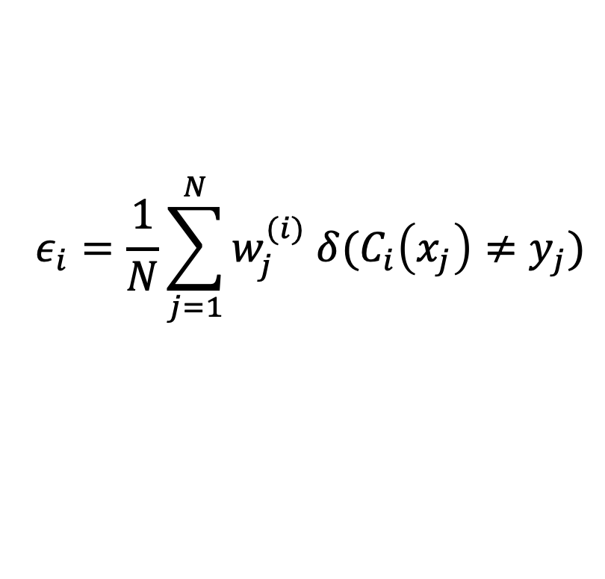
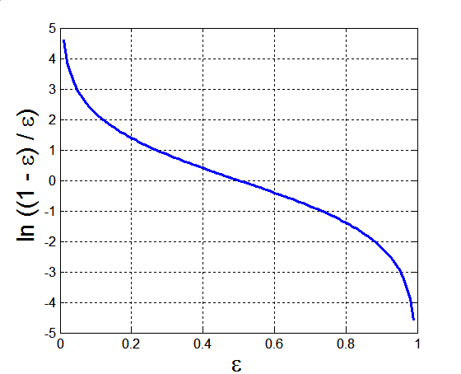
AdaBoost
Base classifiers: C₁, C₂, …, C_{T}
Error rate of a base classifier:
Importance of a classifier:

Slide 90
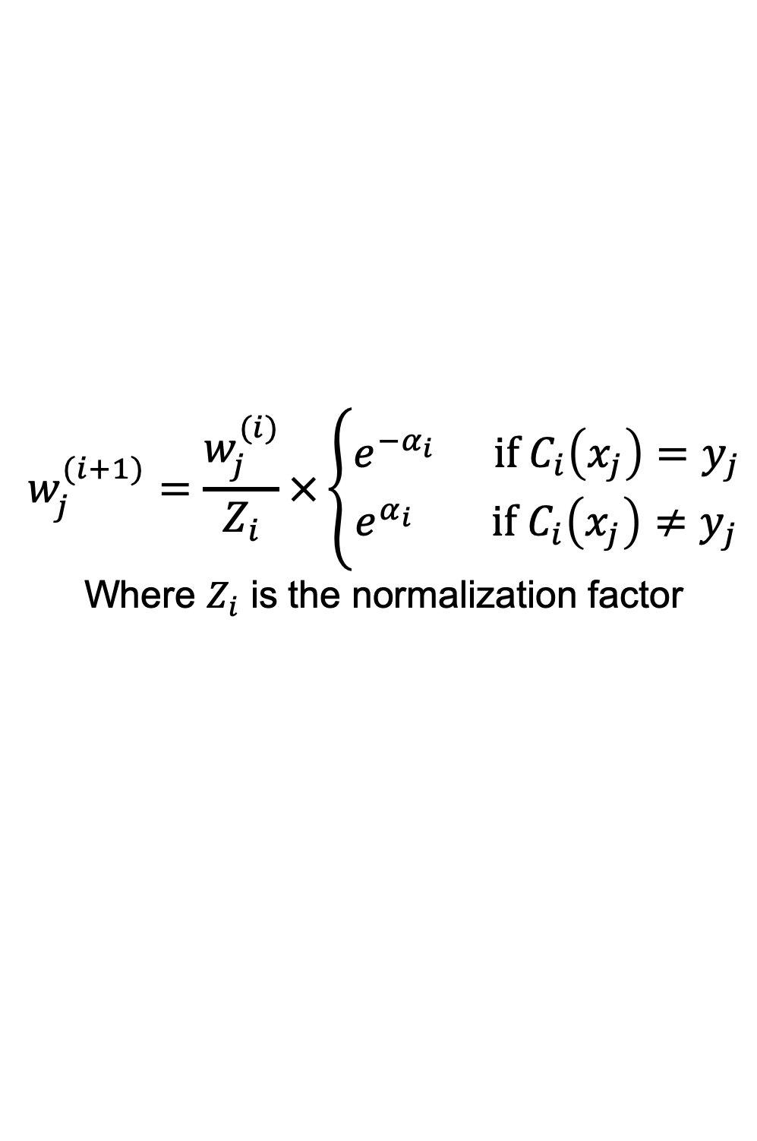
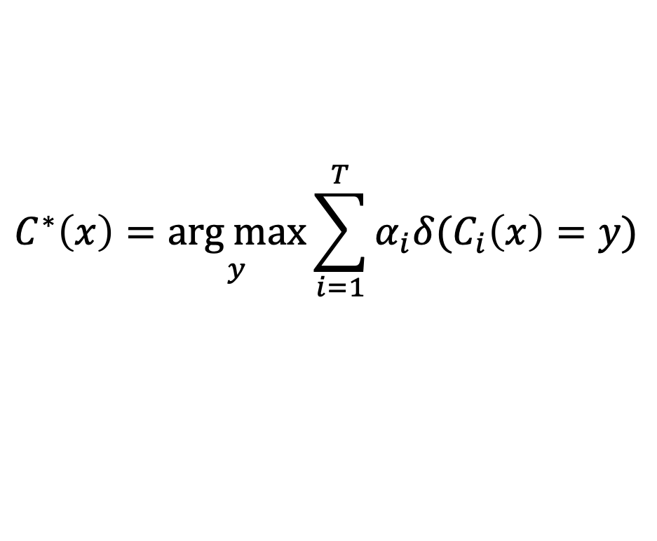
AdaBoost Algorithm
Weight update:
If any intermediate rounds produce error rate higher than 50%, the weights are reverted back to 1/n and the resampling procedure is repeated
Classification:

Slide 91
AdaBoost Example
Consider 1-dimensional data set:
Classifier is a decision stump
Decision rule: x ≤ k versus x > k
Split point k is chosen based on entropy
x ≤ k
True
False
y_{left}
y_{right}

Slide 92
AdaBoost Example
Training sets for the first 3 boosting rounds:
Summary:

Slide 93
AdaBoost Example
Weights
Classification
Predicted Class

Slide 94
Random Forest Algorithm
Construct an ensemble of decision trees by manipulating training set as well as features
Use bootstrap sample to train every decision tree (similar to Bagging)
Use the following tree induction algorithm:
At every internal node of decision tree, randomly sample p attributes for selecting split criterion
Repeat this procedure until all leaves are pure (unpruned tree)

Slide 95
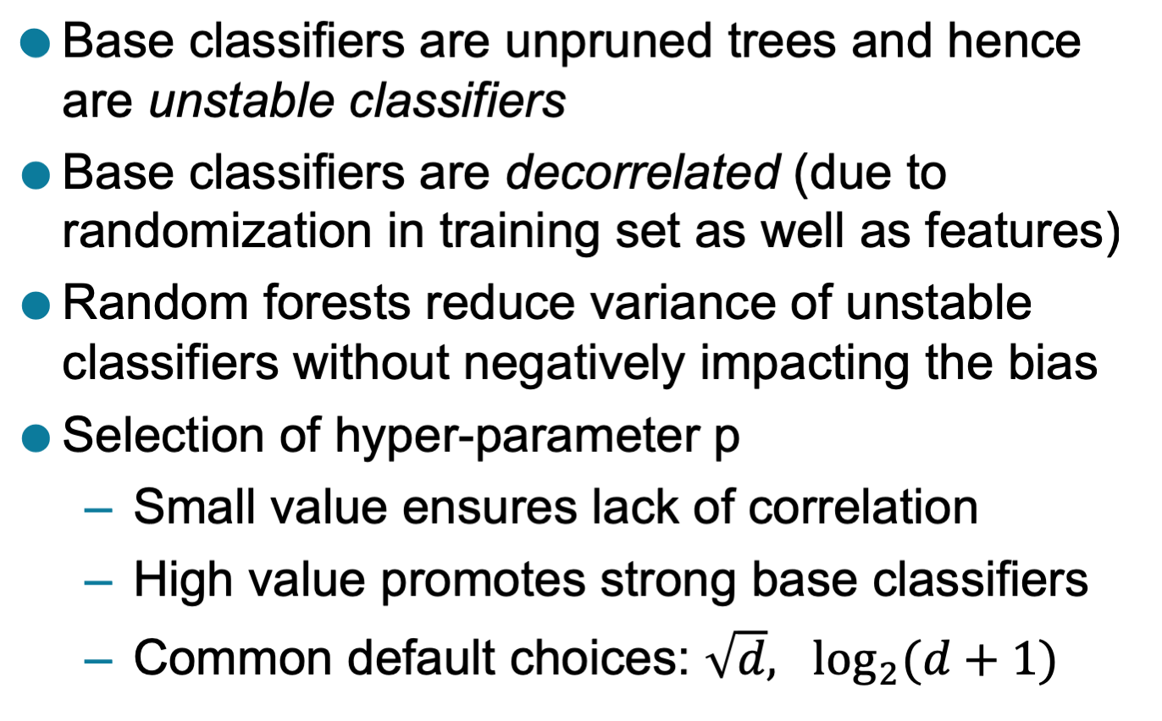
Characteristics of Random Forest

Slide 96
Gradient Boosting
Constructs a series of models
Models can be any predictive model that has a differentiable loss function
Commonly, trees are the chosen model
XGboost (extreme gradient boosting) is a popular package because of its impressive performance
Boosting can be viewed as optimizing the loss function by iterative functional gradient descent.
Implementations of various boosted algorithms are available in Python, R, Matlab, and more.

